Slide 1
Activity diagrams
Dr. Taimoor Khan

Slide 2
Introduction
It shows what happens in a workflow, what activities can be done in parallel and presenting alternative paths
Activity diagram has various if-else and do-until statements to diagram

Slide 3
Elements of activity diagram
Activity state: represent the performance of a step within the workflow
Transitions: show what activity state follows after another.
This type of transition is sometimes referred to as a completion transition, as it is triggered by the completion of an activity and does not need external trigger

Slide 4
Decision: Choosing among multiple alternatives
Guard conditions: Controls which set of alternatives to follow
Alternative threads: multiple possible paths to follow
Synchronization bar: used to show parallel sub-flows. It may join or separate them

Slide 5
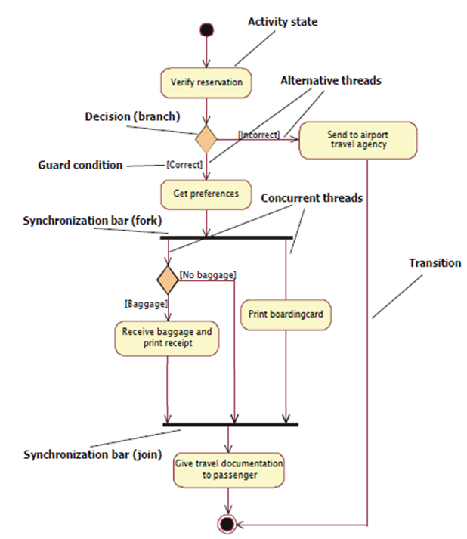

Slide 6
Advanced notations
Conditional threads
Nested activity
Partitions

Slide 7
Conditional thread
They are presented at synchronization bar
A thread that will run in parallel only under certain conditions

Slide 8
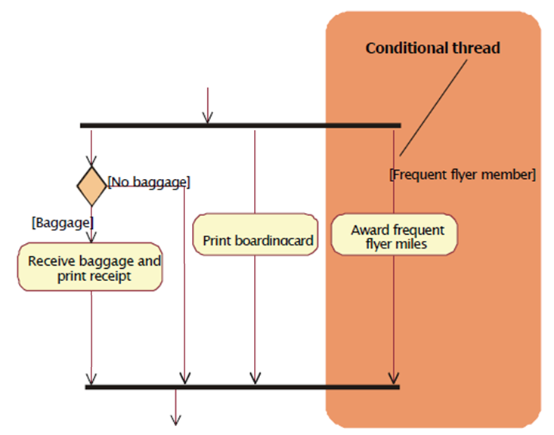
Conditional threads

Slide 9
Nested activity
An activity state may reference another activity diagram which shows the internal structure of that activity state i.e having nested activity graphs
Can be shown in the same diagram or refer to another diagram

Slide 10
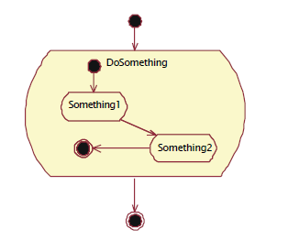
Nested activity

Slide 11
Partitioning
Content of activity diagram is organized into partitions using solid vertical lines
It represents the activities under certain sections / individuals in the organization

Slide 12
